Slide 1
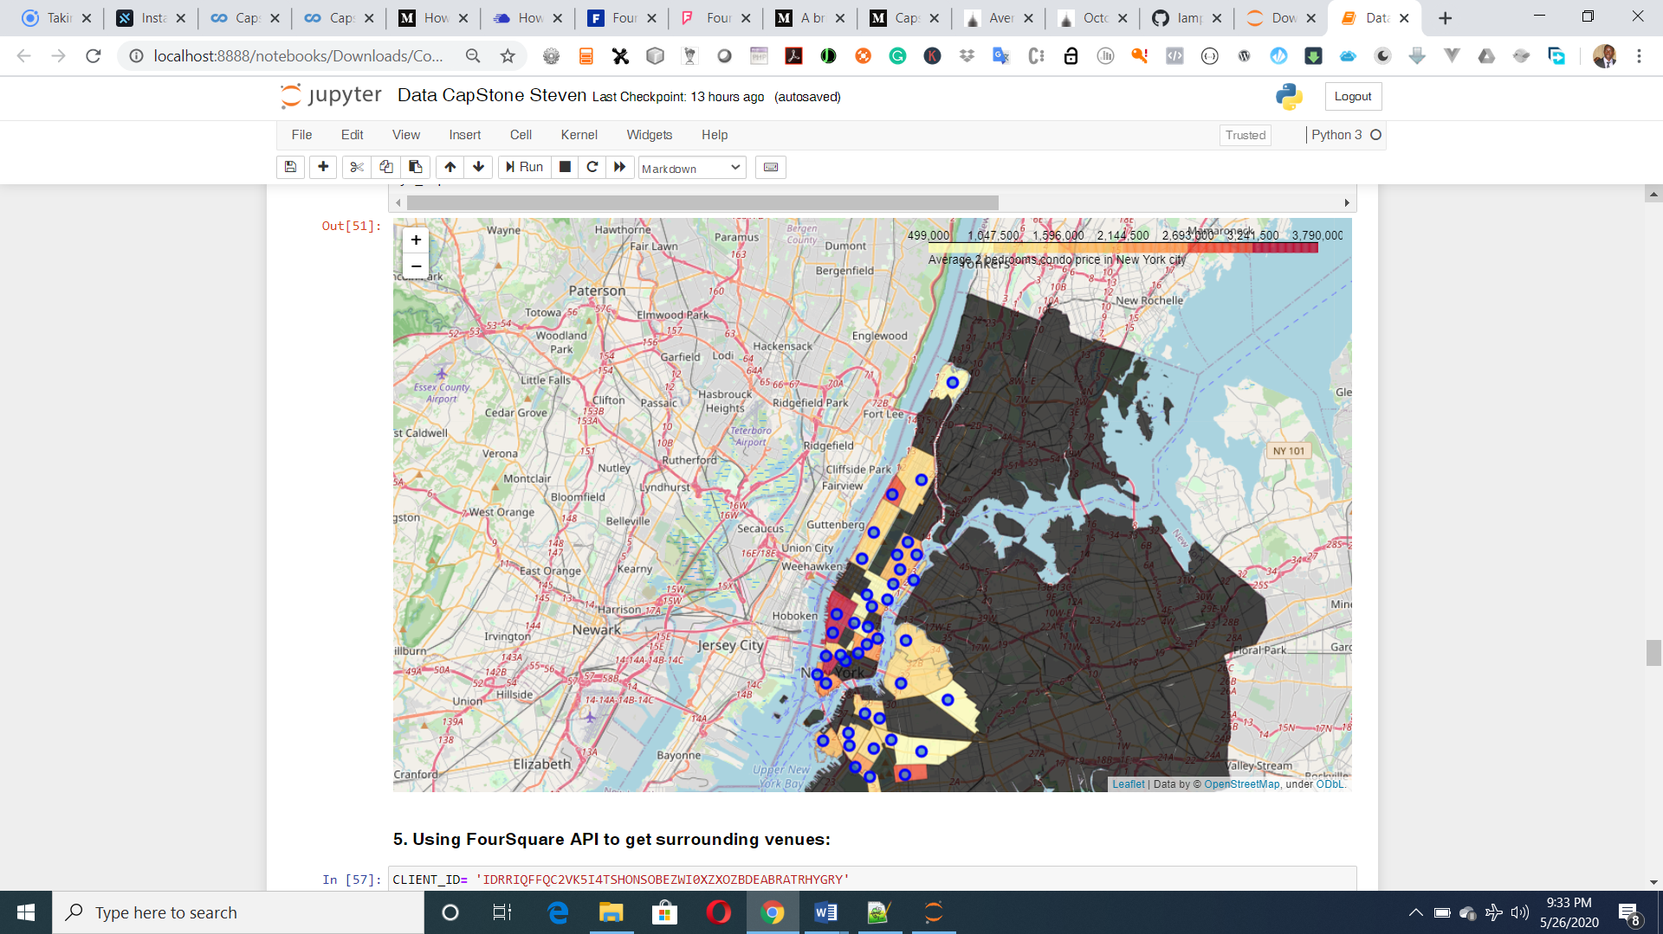
Raziela Company Ltd
The Battle of Neighborhoods
IBM Data Science Certification
Final Report
Oladeji Stephen

Slide 2
Report Content
1. Introduction Section
* The “business problem” to be solved by this project and who may be interested
2. Data Section:
⁃Describe Data requirements and Sources needed to solve the problem
3. Methodology section:
*Data Visualization
*Linear Regression Model
*Principal Component Regression
4. Results section:
*Discussion of the results and finding of answer
5. Discussion section:
*Discussion of observations noted and any recommendations
6. Conclusion section:
*Answer chosen and conclusions.

Slide 3
Introduction
New York city review for Raziela Company.
• Optimum location for new
Restaurant business
• Business Problem :
- Choice of first neighborhood to
start real estate business.
- Easy to replicate.
- Low competition
- High demand
• Success Criteria :
- Best neighborhood which meets above criteria.

Slide 4
New York City - Facts
Most populous city in the United States
It is diverse and is the financial capital of USA
It is multicultural
Provides lot of business opportunities
Business friendly environment
Attracted many different players into the market
Global hub of business and commerce.
The city is a major centre for banking and finance, retailing, world trade, transportation, tourism, real estate, new media, traditional media, advertising, legal services, accountancy, insurance, theatre, fashion, and the arts in the United States.

Slide 5
The intended interest group for this report are:
Potential buyers who can roughly estimate the value of a house based on the surrounding venues and the average price.
Real estate makers and planners who can decide what kind of venues to put around their products to maximize selling price.
Houses sellers who can optimize their advertisements.
And of course, to this course’s instructors and learners who will grade this project. Or to anyone who catch this shared on the social media showing that I can use Python data science tools.

Slide 6
Data Description
New York city neighborhoods were chosen as the observation target due to the following reasons:
The availability of real estate prices. Though very limited.
The diversity of prices between neighborhoods. For example, a 2-bedrooms condo in Central Park West, Upper West Side can cost $4.91 million on average; while in Inwood, Upper Manhattan, just 30 minutes away, it's only $498 thousands.
The availability of geo data which can be used to visualize the dataset onto a map.
The type of real estate to be considered is 2-bedroom condo, which is common for most normal nuclear families.
The dataset will be composed from the following two main sources:
CityRealty which provides the neighborhoods average prices. https://www.cityrealty.com/nyc/market-insight/features/trending-in-ny/october-2018-average-nyc-condo-prices-neighborhood/23921
FourSquare API which provides the surrounding venues of a given coordinates.

Slide 7
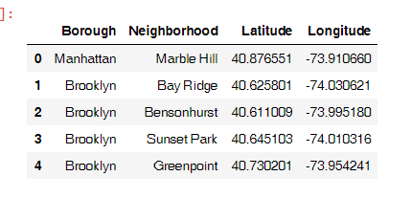
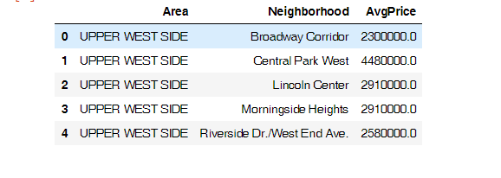
Data Description 2

Slide 8
Methodology
The assumption is that real estate price is dependent on the surrounding venue. Thus, regression techniques will be used to analyze the dataset. The regressors will be the occurrences of venue types. And the dependent variable will be standardized average prices.
At the end, a regression model will be obtained. Along with a coefficients list which describes how each venue type may be related to the increase or decrease of a neighborhood’s real estate average price around the mean.

Slide 9
First insight using visualization
In order to have a first insight of New York city real estate average price between neighborhoods, there is no better way than visualization
Figure 1 - New York city real estate price spread between neighborhoods

Slide 10
Linear Regression
Linear Regression was chosen because it is a simple technique. And by using Sklearn library, implementing the model is quick and easy. Which is perfect to start the analyzing process.
The coefficient list shows some interest and logical information:
“Studios” and “Eateries” both mean businesses. “Train Station” means ease of transportation. All of which usually increase the value of a location.
“Bar” and “Market” sure are nice to visit sometimes but may not be a suitable neighborhood for family with kids. “Lighthouse” and “Golf” usually located in the rural areas. The demand for such locations is usually low.
“TV station”, “Cemetery”, “Laser Tag”, “Mini Golf” all give value to a limited range of people. “Gas Station” is available everywhere. These types of venue usually are not dicision factor when considering a location.

Slide 11
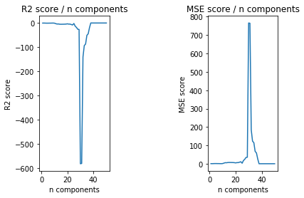
Principal Component Regression (PCR)
PCR employs the power of PCA, which can convert a set of values of possibly correlated variables into a set of values of linearly uncorrelated variables called principal components. As the result, the number of features is reduced while keeping most of the characteristic of the dataset.
R2 score: 0.4538535162982035
MSE: 0.7158743057246335

Slide 12
Results
Even though the scores seem to be improved after applying a more sophisticate method, the model is still not suitable for the dataset. Thus, it can’t be used to precisely predict a neighborhood average price.
Explanations for the poor model can be:
The real estate price is hard to predict.
The data is incomplete (small sample size, missing deciding factors).
The machine learning techniques are chosen or applied poorly.
But again, on the bright side, the insight, gotten from observing the analysis results, seems consistent and logical. And the insight is business venues that can serve the needs

Slide 13
Discussion
The real challenge is constructing the dataset:
Usually the needed data isn’t publicly available.
When combining data from multiple sources, inconsistent can happen. And lots of efforts are required to check, research and change the data before merge.
For data obtained through API calls, different results are returned with different set of parameters and different point of time. Multiple trial and error runs are required to get the optimal result.
Even after the dataset has been constructed, lots of research and analysis are required to decide if the data should be kept as is or be transform by normalization or standardization.
It can be considered the most important process in the whole data science pipeline. Which can affect the most on the result.
On the other hand, choosing the suitable technique to construct the model is also a worthwhile process. As this report shows that, by applying a different method, the result can be improved.

Slide 14
Conclusion
Doing this project helps practicing every topic in the specialization, and thus, equipping learners with Data Science methodology and tools using Python libraries. Also doing a real project certainly helps one learns so much more outside the curriculum, as well as realizes what more to research into after completing the program. And as this report shows, there are surely a lot of things to dig into.
Some notes on the analysis result:
The coefficients only show correlation, not causation. So, if your neighborhood average price is low, please don’t go destroying the surrounding bars and food trucks. There might be another reason.
Toward the person that went through this project, many thanks for the time and patient.

Slide 15
Thank You

